Slide 1
CS2040S Tutorial 4
Done by Xiao Yan

Slide 2
Recap: Quickselect

Slide 3
Quickselect
An algorithm to select the k^{th} smallest element in unsorted array
Derives a similar idea from Quicksort
Observation: When you finish partitioning, the pivot is already at the correct place!
But instead of recursing on both sides, recurse on one side!

Slide 4

select(4)
Initialisation. Want to select 4th smallest elem. Use 1-indexing because easier to think about
10
14
35
32
40
22
7
6
8
1
0
5
Index:
1
2
3
4
5
6
7
8
9
10
11
12

Slide 5
select(4)
Select a random pivot and partition
10
14
35
32
40
22
7
6
8
1
0
5
Index:
1
2
3
4
5
6
7
8
9
10
11
12

Slide 6
select(4)
Select a random pivot and partition
10
14
7
0
5
1
8
6
22
35
32
40
Index:
1
2
3
4
5
6
7
8
9
10
11
12

Slide 7
select(4)
We know that our pivot is actually the 9th smallest element (i.e. we are too high up!)
10
14
7
0
5
1
8
6
22
35
32
40
Index:
1
2
3
4
5
6
7
8
9
10
11
12

Slide 8
select(4)
So we recurse on the left side instead. All while choosing a new pivot
10
14
7
0
5
1
8
6
22
32
40
6
35
Index:
1
2
3
4
5
6
7
8
9
10
11
12

Slide 9
select(4)
Partitioning…
1
0
5
7
6
14
10
6
22
32
40
8
35
Index:
1
2
3
4
5
6
7
8
9
10
11
12

Slide 10
select(4)
Our pivot 5 was actually the 3rd smallest element. Too low!
1
0
5
7
6
14
10
6
22
32
40
8
35
Index:
1
2
3
4
5
6
7
8
9
10
11
12

Slide 11
select(4)
Recurse to the right, and so on!
1
0
5
7
6
14
10
6
22
32
40
8
35
Index:
1
2
3
4
5
6
7
8
9
10
11
12
It is more important to understand the idea behind quickselect rather than being caught up in the indexing issues.

Slide 12
Quickselect Analysis
For an array of size n...
Recurrence Relation:
Time Complexity:

Slide 13
Quickselect Analysis
For an array of size n...
Recurrence Relation: T(n) = T(n / 2) + O(n)
Time Complexity: O(n)

Slide 14
Ordered Dictionary ADT
It should guarantee these operations:
Notes:
abstract data type (ADT) is a mathematical model for data types. ... Formally, an ADT may be defined as a "class of objects whose logical behavior is defined by a set of values and a set of operations"; this is analogous to an algebraic structure in mathematics.

Slide 15
Ordered Dictionary ADT(Abstract data type)
It should guarantee these operations:
insert(key, value)
search(key)
delete(key)
contains(key)
successor(key)
predecessor(key)
size()
Notes:
Ideally you want to do all these efficiently
Ordered - means that the elements in the ADT follow a certain order
Dictionary - means that each element has a key (a “label” for each value inside the dictionary)

Slide 16
Binary trees
x
BT or empty tree
BT or empty tree
Left subtree
Right subtree

Slide 17
Binary trees
Conceptually, we often visually represent a binary tree in the following form
x
Root node containing the node’s key x
We call this a node in the tree
BT or empty tree
BT or empty tree
Left subtree
Right subtree
Realize that this diagram applies to EVERY NODE in the BT?
I.E. every node in the BT is itself a BT!
Notes:
Every node in a binary tree consists of a left and right children which are also binary trees

Slide 18
Height of a node
Definition: Number of edges on the longest path from from node to leaf

Slide 19
Height of a node
Definition: Number of edges on the longest path from from node to leaf
For this node, which is the longest path to leaf?
6
3
8
2
5
9
7

Slide 20
Height of a node
Definition: Number of edges on the longest path from from node to leaf
For this node, which is the longest path to leaf?
6
3
8
2
5
9
7

Slide 21
Height of a node
Definition: Number of edges on the longest path from node to leaf
For this node, which is the longest path to leaf?
6
How many edges are there in that path?
3
8
2
5
9
7

Slide 22
Height of a node
Definition: Number of edges on the longest path from from node to leaf
For this node, which is the longest path to leaf?
6
How many edges are there in that path?
3
Therefore this node has height 3
3
8
2
5
9
7

Slide 23
Height of a node
Definition: Number of edges on the longest path from from node to leaf
What’s the height of this node?
6
3
8
2
5
9
7

Slide 24
Height of a node
Definition: Number of edges on the longest path from from node to leaf
What’s the height of this node?
6
3
8
2
5
9
7

Slide 25
Depth of a node
Definition: Number of edges to the root

Slide 26
Depth of a node
Definition: Number of edges to the root
6
3
8
2
5
9
7

Slide 27
Depth of a node
Definition: Number of edges to the root
For this node, how many edges are needed to go up to the root?
6
3
8
2
5
9
7

Slide 28
Depth of a node
Definition: Number of edges to the root
For this node, how many edges are needed to go up to the root?
3
6
3
8
2
5
9
7

Slide 29
Depth of a node
Definition: Number of edges to the root
For this node, how many edges are needed to go up to the root?
6
3
8
2
5
9
7

Slide 30
Depth of a node
Definition: Number of edges to the root
For this node, how many edges are needed to go up to the root?
6
3
8
2
5
9
7

Slide 31
Binary Search Trees (BST)

Slide 32
Binary Search Trees (BST)
It is a binary tree with the following properties:
A node’s left subtree contains nodes strictly less than the node’s key
A node’s right subtree contains nodes strictly greater than the node’s key
The left and right subtrees are binary trees
All keys belong to a total order (no two different keys can be considered equal)

Slide 33
Binary Search Trees (BST)
It is a binary tree with the following properties:
A node’s left subtree contains nodes strictly less than the node’s key
A node’s right subtree contains nodes strictly greater than the node’s key
The left and right subtrees are binary trees
All keys belong to a total order (no two different keys can be considered equal)
Common mistake: Thinking that only the direct left/right child have to be less/greater. It is ALL the nodes in the left/right SUBTREE

Slide 34
Binary Search Trees (BST)
x
<x
>x
Notes:
When you check whether something is a binary search tree recursively, you cannot just check whether x is between the left and right subtree. You have to keep a record of the min,max so that the biggest successor of your left child is smaller than the parent

Slide 35
Is this a BST?
6
3
8
2
5
9
7

Slide 36
Is this a BST?
6
3
8
2
5
9
7
Question 1
NO! Compare these two nodes and notice that 7 belongs to the right subtree of 8

Slide 37
Is this a BST?
6
3
8
2
5
9
7
Question 1
If you were to (wrongly) use the idea that only the direct left/right childs have to be smaller/greater, then this fits. BUT THIS IS NOT A BST

Slide 38
Is this a BST?
6
3
8
2
5
9
Question 2
Is this a BST?

Slide 39
Is this a BST?
6
3
8
2
5
9
2
3
5
6
8
9
#LIFEHACKS
If you “drop” every node and it appears like a sorted sequence, then it is a BST

Slide 40
Is this a BST?
5
2
3
1
4
9
Question 3
BST?

Slide 41
Is this a BST?
5
2
3
1
4
9
Question 3
Nope! Either use the “dropping” method or observe that 3 is in the right subtree of 5

Slide 42
Is this a BST?
3
2
1
Question 4
Fun fact: Donald Knuth, the “father of analysis of algorithms” is still writing a book called The Art Of Computer Programming since 1968

Slide 43

Is this a BST?
3
2
1
Question 4
Yeboi

Slide 44

Is this a BST?
3
Question 5
Fun fact: COM3 which is being built, is the first building that is built for SoC (we inherited COM1 and COM2 from Law i think)

Slide 45
Is this a BST?
3
Question 5
This lonely boi is also a BST!
(You can think of the left and right childs being empty trees)

Slide 46
Summary
h(v) - height of a node: Number of edges on the longest path from node to leaf.
h(v) = 0 (if v is a leaf)
h(v) = max(h(v.left), h(v.right)) + 1

Slide 47
Questions?

Slide 48
Operations in a BST
Searching
Insertion
Search Minimum and Maximum
Successor and Predecessor
Delete
Traversal

Slide 49
Operations in a BST
Searching
Insertion
Search Minimum and Maximum
Successor and Predecessor
Delete
Traversal

Slide 50
Searching
Idea:
Compare root vs element you are looking for
If element == root, found!
Else if element < root, recurse to the left subtree
Else element > root, recurse to the right subtree

Slide 51
Searching
search(144)
Initialisation
34
5
233
2
13
89
610
1
3
8
21
55
144
377
987

Slide 52
Searching
search(144)
Compare 144 with 34
34
5
233
2
13
89
610
1
3
8
21
55
144
377
987

Slide 53
Searching
search(144)
144 is greater than 34. Since we are in BST, we are guaranteed that 144 cannot be in the left subtree
34
5
233
2
13
89
610
1
3
8
21
55
144
377
987

Slide 54
Searching
search(144)
Compare 144 with 23
34
5
233
2
13
89
610
1
3
8
21
55
144
377
987

Slide 55
Searching
search(144)
144 is less than 233. We can ignore the right subtree
34
5
233
2
13
89
610
1
3
8
21
55
144
377
987

Slide 56
Searching
search(144)
Compare 144 with 89
34
5
233
2
13
89
610
1
3
8
21
55
144
377
987

Slide 57
Searching
search(144)
144 is greater than 89 so we can ignore the left subtree
34
5
233
2
13
89
610
1
3
8
21
55
144
377
987

Slide 58
Searching
search(144)
Compare 144 with 144, and found!
34
5
233
2
13
89
610
1
3
8
21
55
144
377
987

Slide 59
Searching (eg2)
search(145)
If for example we are searching for 145 instead of 144. Notice that everything is the same up to this point
34
5
233
2
13
89
610
1
3
8
21
55
144
377
987

Slide 60
Searching
Searching (eg2)
search(145)
145 is greater than 89 so we can ignore the left subtree
34
5
233
2
13
89
610
1
3
8
21
55
144
377
987

Slide 61
Searching
Searching (eg2)
search(145)
Compare 145 with 144
34
5
233
2
13
89
610
1
3
8
21
55
144
377
987

Slide 62
Searching
Searching (eg2)
search(145)
We are supposed to explore the right subtree, but 144 does not have a right subtree!
We can report ‘not found’
34
5
233
2
13
89
610
1
3
8
21
55
144
377
987

Slide 63
Searching
Searching (eg3)
search(987)
Initialisation
8
21
55
144
377
987

Slide 64
Searching
Searching (eg3)
search(987)
Compare 987 with 8
8
21
55
144
377
987

Slide 65
Searching
Searching (eg3)
search(987)
987 cannot be in the left subtree. So we explore the right subtree
8
21
55
144
377
987

Slide 66
Searching
Searching (eg3)
search(987)
Compare 987 with 21
8
21
55
144
377
987

Slide 67
Searching
Searching (eg3)
search(987)
Also the same thing. Go right!
8
21
55
144
377
987

Slide 68
Searching
Searching (eg3)
search(987)
and so on...
8
21
55
144
377
987

Slide 69
Searching
Searching (eg3)
search(987)
will spare you the agony of going through several slides xD
8
21
55
144
377
987

Slide 70
Searchmin and Searchmax
Where are the smallest and largest elements located in the tree?
34
5
233
2
13
89
610
1
3
8
21
55
144
377
987

Slide 71
Searchmin and Searchmax
Where are the smallest and largest elements located in the tree?
34
5
233
2
13
89
610
1
3
8
21
55
144
377
987

Slide 72
Searchmin and Searchmax
Where are the smallest and largest elements located in the tree?
34
5
233
2
13
89
610
Leftmost of the tree
1
3
8
21
55
144
377
987
Rightmost of the tree

Slide 73

Searchmin and Searchmax
The idea:
Just keep going down the left subtree (for min) or the right subtree (for max) ‘til you can’t no more

Slide 74
Questions?

Slide 75
Successor and Predecessor

Slide 76
Successor and Predecessor
The successor of key x is basically the “next bigger key” in the tree
The predecessor of key x is basically the “previous smaller key” in the tree

Slide 77
Successor and Predecessor
The successor of key x is basically the “next bigger key” in the tree
The predecessor of key x is basically the “previous smaller key” in the tree
Another way to think about it: If you perform an in-order traversal (“write the keys in sorted order”), the successor is the next one in the sorted sequence and the predecessor is the previous one in the sorted sequence*
*If the key doesn’t exist in the tree, pretend you have inserted it in the sorted order for visualisation

Slide 78
Successor (Case 1)
successor(34)
Who is the successor of 34?
34
5
233
2
13
89
610
1
3
8
21
55
144
377
987

Slide 79
Successor (Case 1)
successor(34)
It’s 55!
34
5
233
2
13
89
610
1
3
8
21
55
144
377
987

Slide 80
Successor (Case 1)
successor(34)
Do you notice something about where 55 is located?
34
5
233
2
13
89
610
1
3
8
21
55
144
377
987

Slide 81
Successor (Case 1)
successor(34)
It’s the smallest element of 34’s right subtree!
(The smallest right child)
34
5
233
2
13
89
610
1
3
8
21
55
144
377
987

Slide 82
Successor (Case 2)
successor(21)
What if the node doesn’t have a right subtree like this node with key 21 here?
First, what is this node’s successor?
34
5
233
2
13
89
610
1
3
8
21
55
144
377
987

Slide 83
Successor (Case 2)
successor(21)
34 is the successor. How did we get to 34?
34
5
233
2
13
89
610
1
3
8
21
55
144
377
987

Slide 84
Successor (Case 2)
successor(21)
Essentially, keep going up the tree until we have to “climb to the right”
(the smallest right parent)
34
5
233
2
13
89
610
1
3
8
21
55
144
377
987

Slide 85
Successor (Case 2)
successor
Verify that this pattern holds for other cases
34
5
233
2
13
89
610
1
3
8
21
55
377
987

Slide 86
Questions?

Slide 87
Tutorial Time

Slide 88
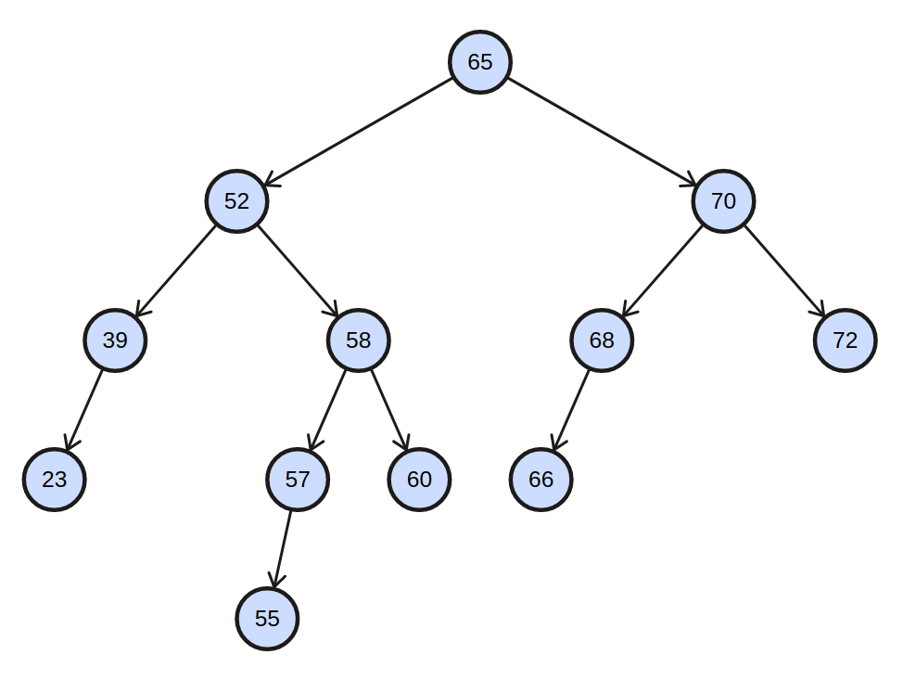
Problem 1: AVL Tree Review
Trace the deletion of the node with the key 70.

Slide 89
Problem 1: AVL Tree Review
First, find the successor of 70, which is 72.

Slide 90
Problem 1: AVL Tree Review
Copy the value of the successor over.
72

Slide 91
Problem 1: AVL Tree Review
Then, delete the successor.
72

Slide 92
Problem 1: AVL Tree Review
h = 4
Now, the subtree rooted at the node with key 72 is unbalanced!
h = 3
72
h = 2
h = 1
h = 2
h = 1
h = 0
h = 1
h = 0
h = 0
h = 0

Slide 93
Problem 1: AVL Tree Review
h = 4
Let the node with key 72 be v.
h = 3
72
h = 2
h = 1
h = 2
h = 1
h = 0
h = 1
h = 0
h = 0
h = 0

Slide 94
Problem 1: AVL Tree Review
h = 4
Let the node with key 72 be v.
v is out of balance and left heavy.
h = 3
72
h = 2
h = 1
h = 2
h = 1
h = 0
h = 1
h = 0
h = 0
h = 0

Slide 95
Problem 1: AVL Tree Review
h = 4
Let the node with key 72 be v.
v is out of balance and left heavy.
v.left is left heavy.
h = 3
72
h = 2
h = 1
h = 2
h = 1
h = 0
h = 1
h = 0
h = 0
h = 0

Slide 96
Problem 1: AVL Tree Review
h = 4
Let the node with key 72 be v.
v is out of balance and left heavy.
v.left is left heavy.
Perform a right rotation on v!
h = 3
72
h = 2
h = 1
h = 2
h = 1
h = 0
h = 1
h = 0
h = 0
h = 0

Slide 97
Problem 1: AVL Tree Review
h = 4
Let the node with key 72 be v.
v is out of balance and left heavy.
v.left is left heavy.
Perform a right rotation on v!
h = 3
68
h = 1
h = 1
h = 2
66
h = 0
h = 0
h = 0
h = 1
h = 0
h = 0

Slide 98
Problem 1: AVL Tree Review
h = 4
Now, the subtree rooted at the node with key 65 is unbalanced.
h = 3
68
h = 1
h = 1
h = 2
66
h = 0
h = 0
h = 0
h = 1
h = 0
h = 0

Slide 99
Problem 1: AVL Tree Review
h = 4
Let the node with key 65 be v.
h = 3
68
h = 1
h = 1
h = 2
66
h = 0
h = 0
h = 0
h = 1
h = 0
h = 0

Slide 100
Problem 1: AVL Tree Review
h = 4
Let the node with key 65 be v.
v is out of balance and left heavy.
h = 3
68
h = 1
h = 1
h = 2
66
h = 0
h = 0
h = 0
h = 1
h = 0
h = 0

Slide 101
Problem 1: AVL Tree Review
h = 4
Let the node with key 65 be v.
v is out of balance and left heavy.
v.left is right heavy.
h = 3
68
h = 1
h = 1
h = 2
66
h = 0
h = 0
h = 0
h = 1
h = 0
h = 0

Slide 102
Problem 1: AVL Tree Review
h = 4
Let the node with key 65 be v.
v is out of balance and left heavy.
v.left is right heavy.
Perform a left rotation on v.left, then a right rotation on v!
h = 3
68
h = 1
h = 1
h = 2
66
h = 0
h = 0
h = 0
h = 1
h = 0
h = 0

Slide 103
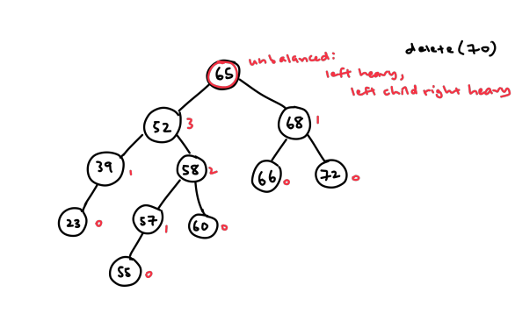

Slide 104
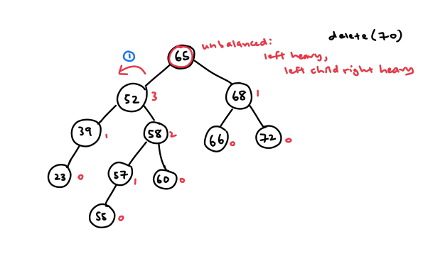

Slide 105
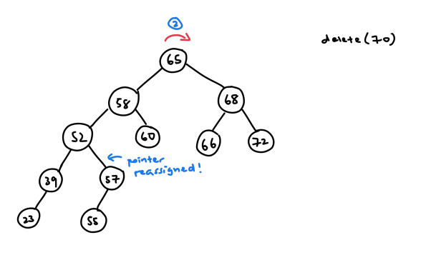

Slide 106
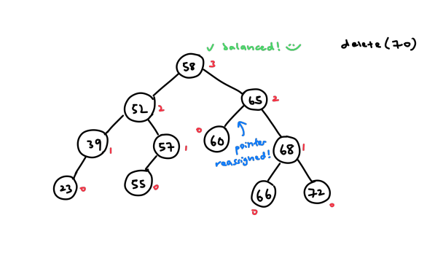

Slide 107
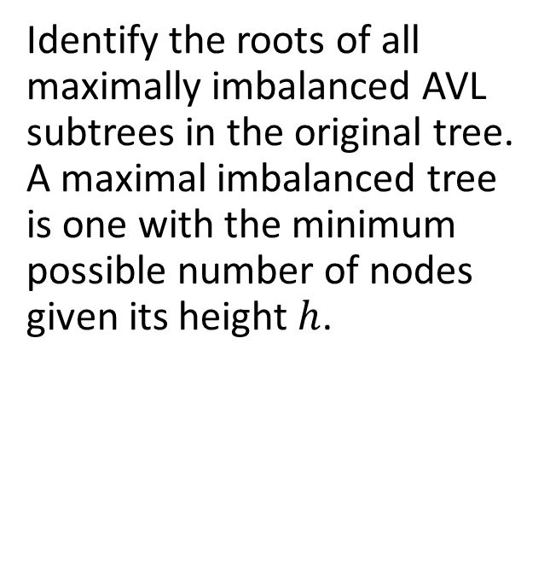
Problem 1b: AVL Tree Review

Slide 108
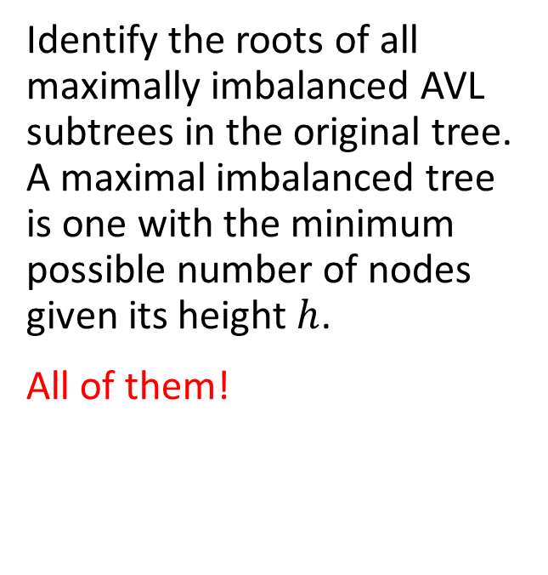
Problem 1: AVL Tree Review

Slide 109
Problem 1: AVL Tree Review
h = 4
h = 3
72
h = 2
h = 1
h = 2
h = 1
h = 0
h = 0
h = 1
h = 0
h = 0
h = 0

Slide 110
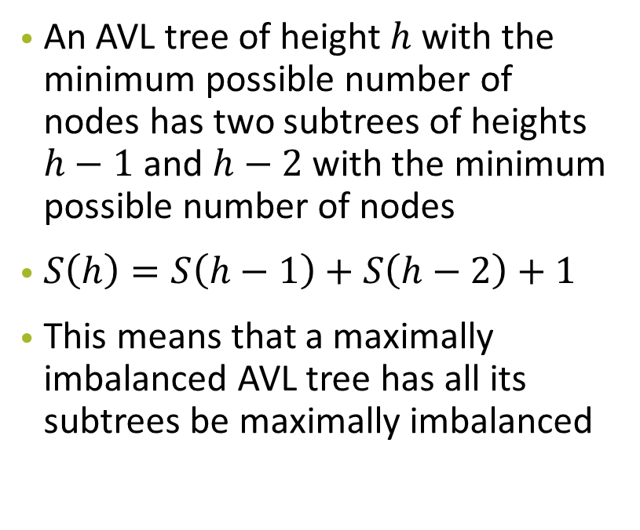
Problem 1: AVL Tree Review
h = 4
h = 3
72
h = 2
h = 1
h = 2
h = 1
h = 0
h = 0
h = 1
h = 0
h = 0
h = 0

Slide 111
Problem 1c: AVL Tree Review
During lectures, we’ve learnt that we need to store and maintain height information for each AVL tree node to determine if there is a need to rebalance the AVL tree during insertion and deletion. However, if we store height as an int, each tree node now requires 32 extra bits. Can you think of a way to reduce the extra space required for each node to 2 bits instead?

Slide 112
Problem 1c: AVL Tree Review
Store and maintain the balance factor for each node instead, i.e. the height difference between the left and right subtrees
Can only be -1, 0 or 1 -> only need 2 bits

Slide 113
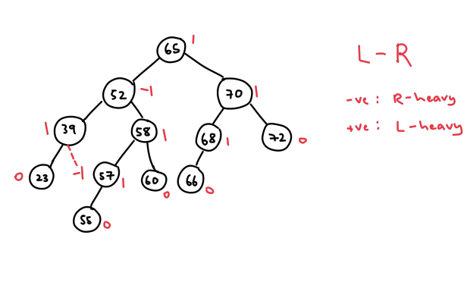

Slide 114
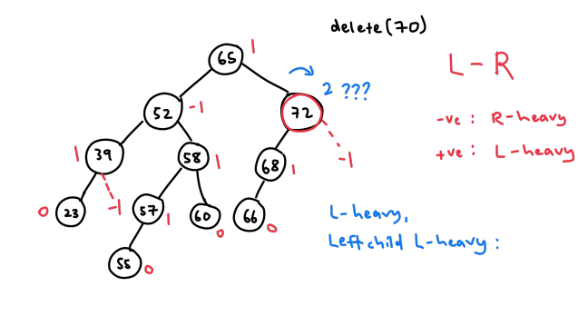

Slide 115
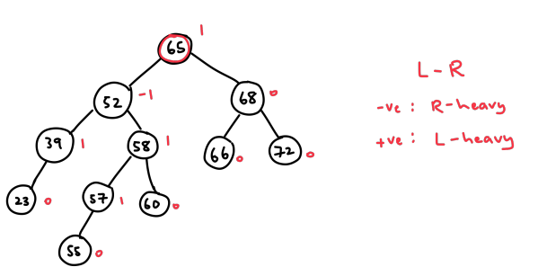

Slide 116
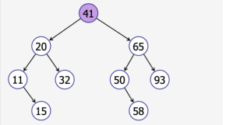
Problem 1d: Binary Search Tree Review
Given a pre-order traversal result of a binary search tree T, suggest an algorithm to reconstruct the original tree T. (From lecture review)
Sequence: 41, 20, 11, 15, 32, 65, 50, 58, 93.

Slide 117
41, 20, 11, 15, 32, 65, 50, 58, 93.
By definition of pre-order traversal, 41 should be the key of root
21 which is the first element < 41 should be the key of root of left child
65 which is the first element > 41 should be the key of root of right child
Now we know that sequence 20, 11, 15, 32 belongs to left tree while
Sequence 65, 50, 58, 93 belongs to right.
Recurse on both left sequence and right sequence to get two BST, which is the left child and right child to the root of key 41

Slide 118
Problem 2: Iterative BFS and DFS
During lecture, we’ve learnt how to do tree traversal in various ways. For this question, we’ll focus on DFS and BFS. Since you already know how to use DFS and BFS to traverse a tree recursively, can you propose a way using non-recursive DFS and BFS to traverse a tree? Write your answer in the form of pseudocode.

Slide 119
Use Stack/Queue !!!
Stack -> LIFO (Last-In-First-Out), Queue -> FIFO (First-In-FirstOut).
For DFS, use Stack.
1. push the root of tree into Stack,
2. pop from Stack and get the popped node and that’s the node you’re visiting.
3. push all of its children into that Stack
Perform step 2 and 3 repetitively until Stack is empty:
When the Stack is empty, all the nodes have been visited and we have finished the DFS traversal. Similarly, for BFS, all the operations are the same except that now we use Queue instead of Stack to store all the nodes.

Slide 120
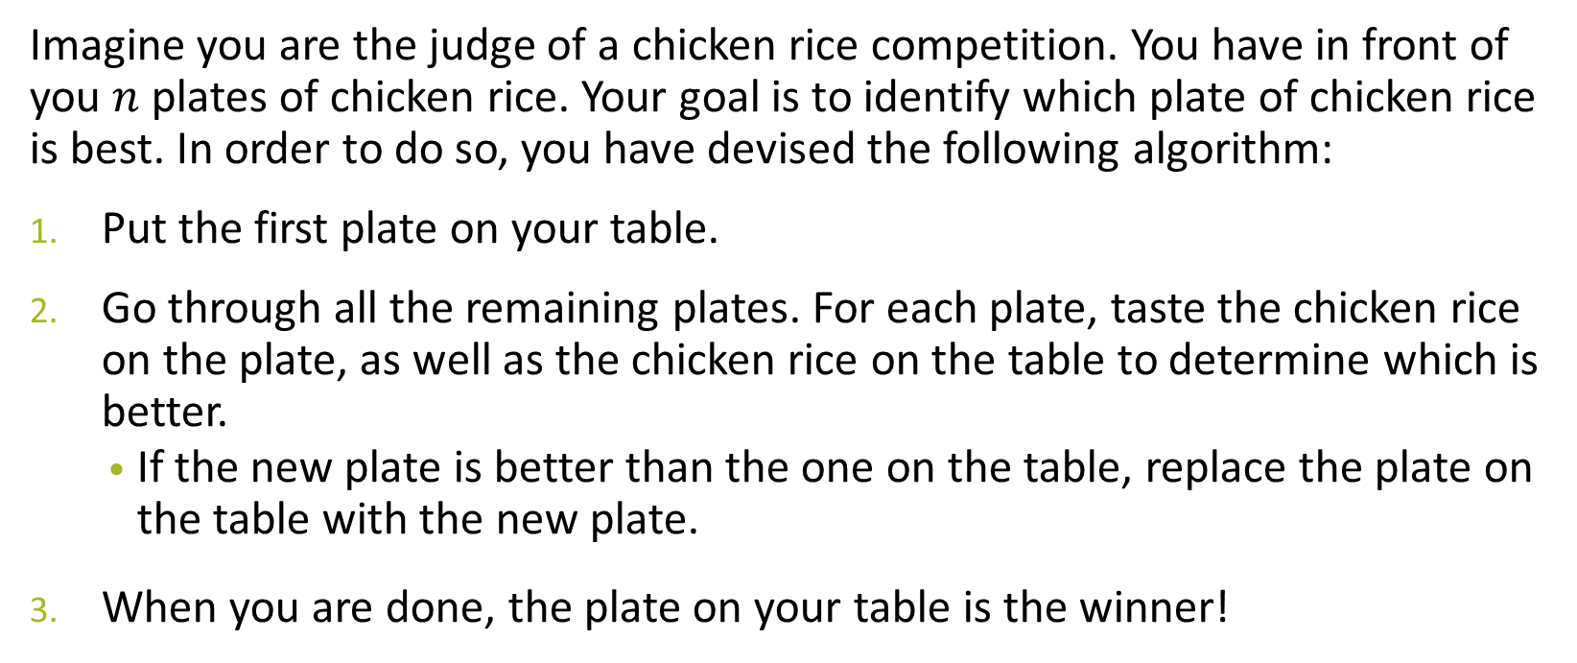
Problem 3a: Chicken Rice

Slide 121
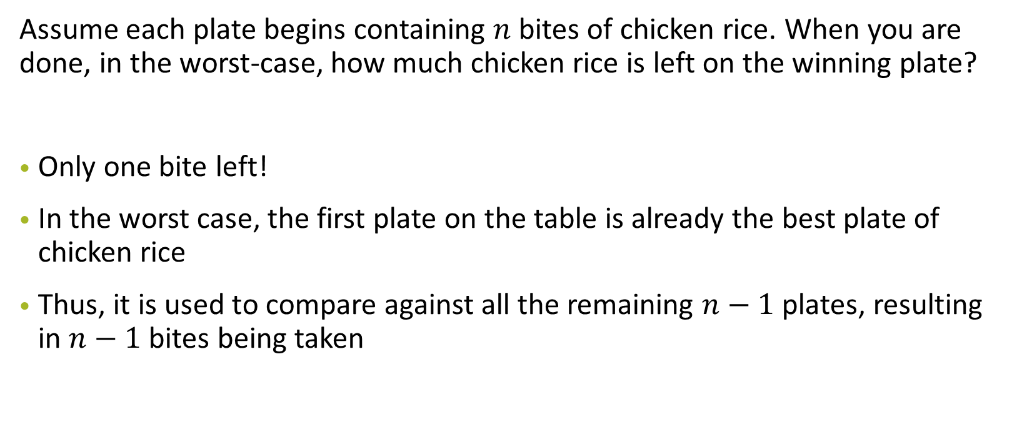
Problem 3a: Chicken Rice

Slide 122
Problem 3a: Chicken Rice

Slide 123
Problem 3b: Chicken Rice
Oh no! We want to make sure that there is as much chicken rice left on the winning plate as possible (so you can take it home and give it to all your friends). Design an algorithm to maximise the amount of remaining chicken rice on the winning plate, once you have completed the testing/tasting process.
How much chicken rice is left on the winning plate?
How much chicken rice have you had to consume in total?
Give a tight asymptotic bound for both questions above.

Slide 124
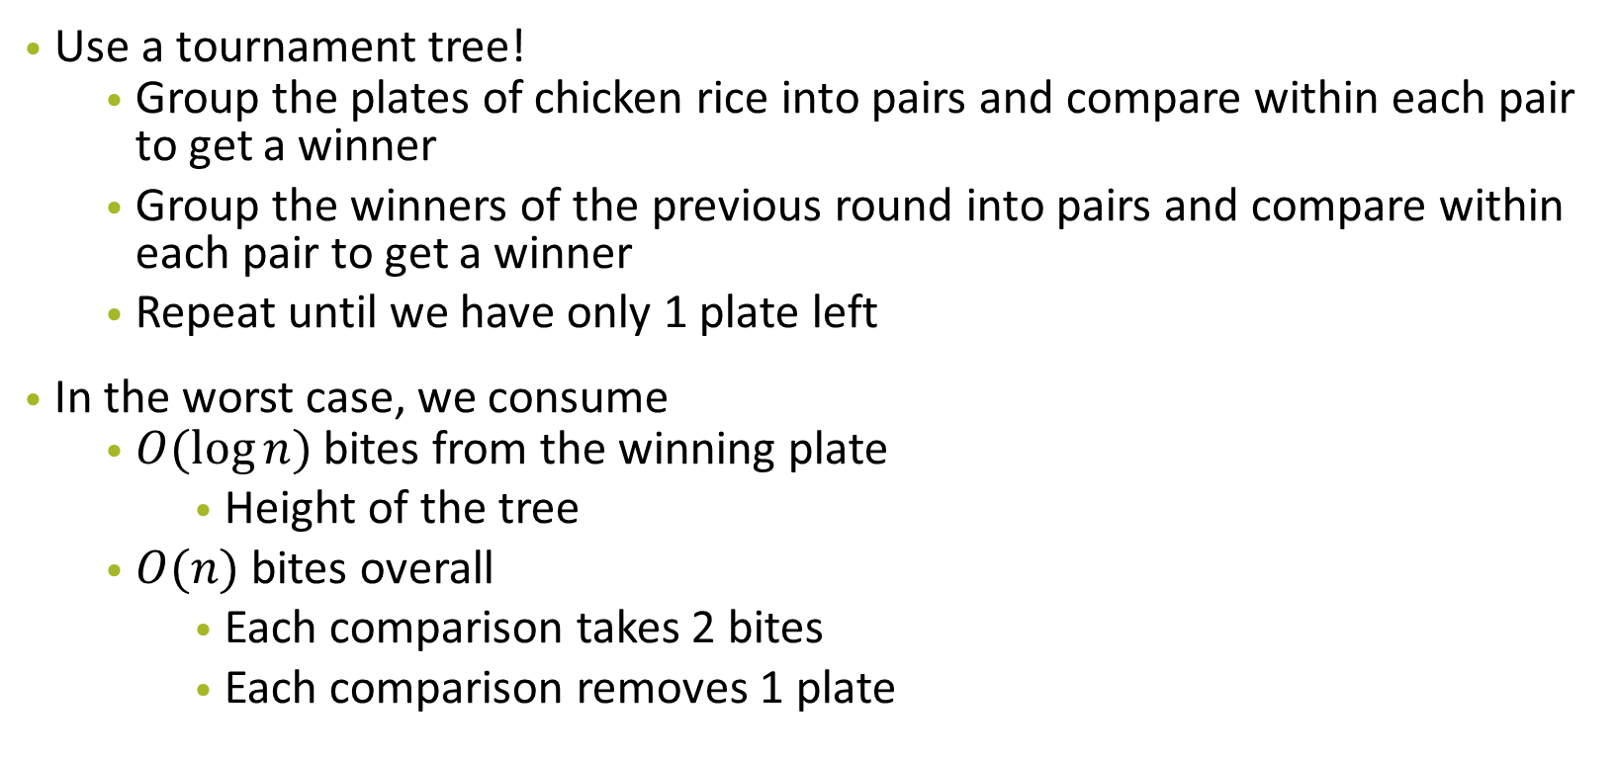
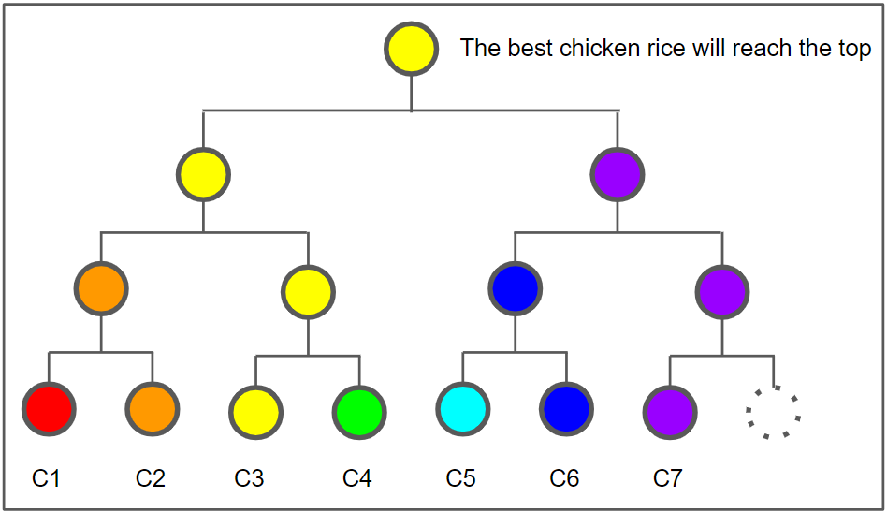
Problem 3b: Chicken Rice

Slide 125
Problem 3c: Chicken Rice
Now, I do not want to find the best chicken rice, but the median chicken rice. Again, design an algorithm to maximise the amount of remaining chicken rice on the median plate once you have completed the testing/tasting process.
How much chicken rice is left on median plate?
How much chicken rice have you had to consume in total?
Give a tight asymptotic bound for both questions above. If your algorithm is randomised, give your answers in expectation.

Slide 126
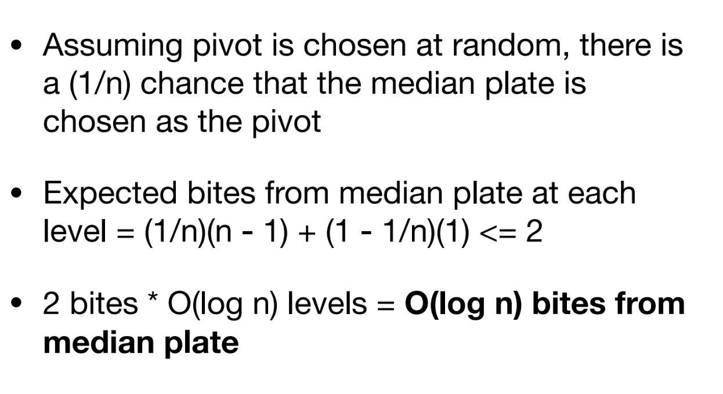
Problem 3c: Chicken Rice

Slide 127
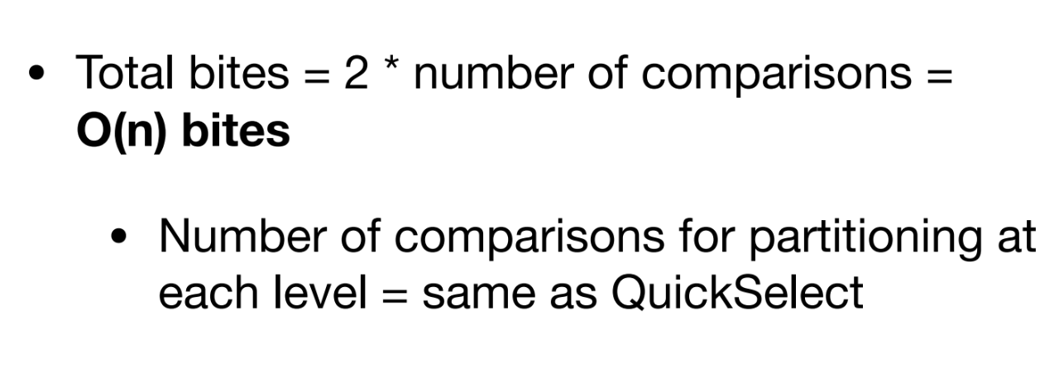
Problem 3c: Chicken Rice

Slide 128
Problem 3c: Chicken Rice
• A deterministic solution?

Slide 129
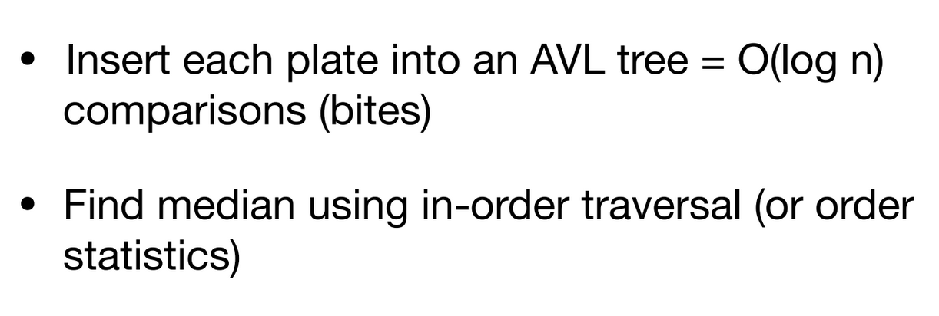
Problem 3c: Chicken Rice

Slide 130
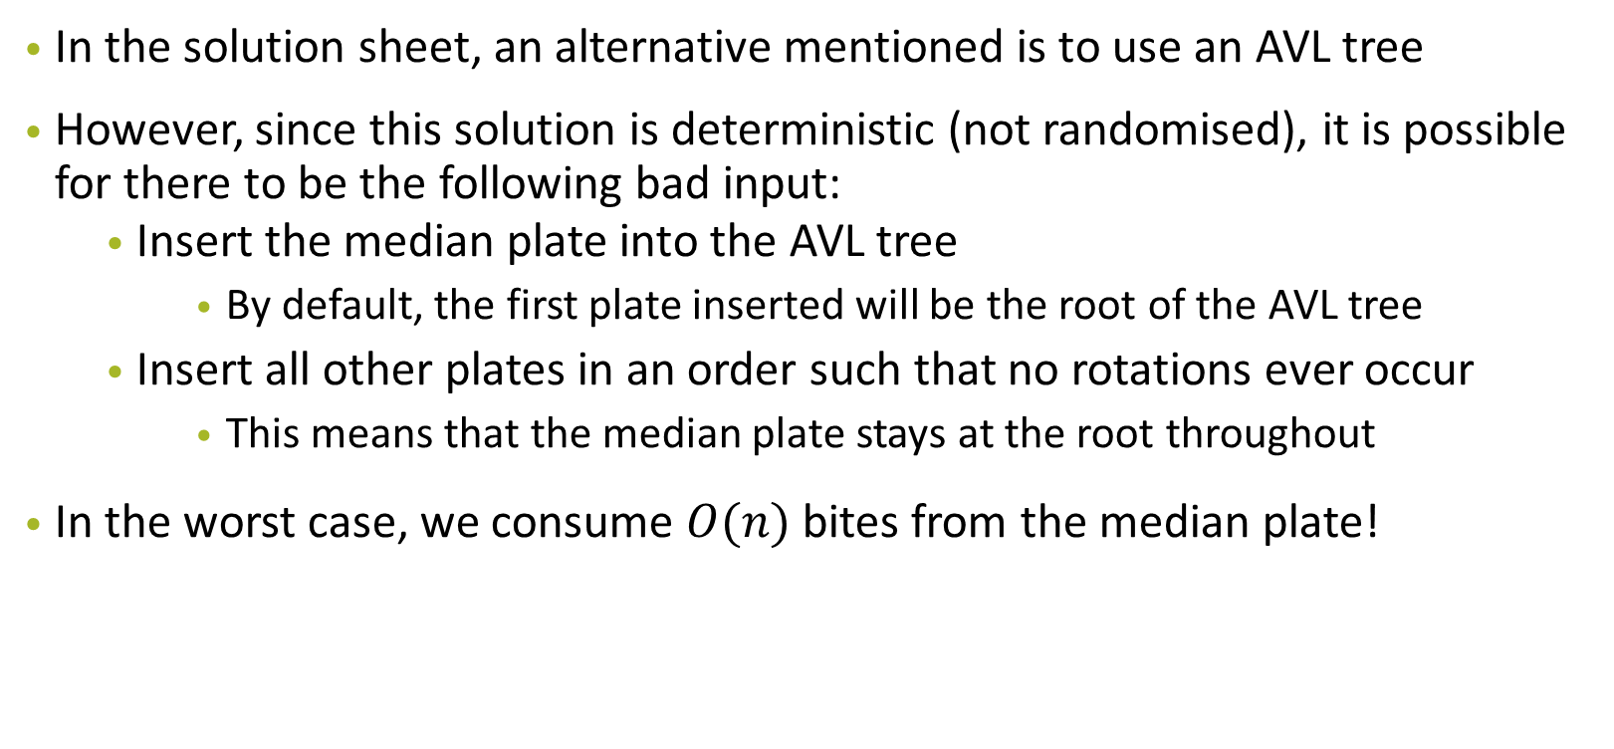
Problem 3c: Chicken Rice

Slide 131
Problem 3c: Chicken Rice -
Better solution??
• O(loglogn) bites!
• https://arxiv.org/pdf/1901.02857.pdf

Slide 132
Problem 4: Economic Research

Slide 133
Problem 4: Economic Research
Main Question Idea: You want to divide the dataset into “equi-wealth” age ranges, and given parameter k, you should output k different lists A₁, A₂, ..., A_{k} with the following properties:
All the ages of people in set A_{j} should be less than or equal to the ages of people in A_{j+1}. That is, each set should be a subset of the original dataset containing a contiguous age range.
The sum of wealth in each set should be (roughly) the same

Slide 134

Problem 4: Example
18 yo, wealth: 1,000
24 yo, wealth: 150,000
32 yo, wealth: 42,000
60 yo, wealth: 109,000
78 yo, wealth: 151,000

Slide 135
Problem 4: Example
18 yo, wealth: 1,000
24 yo, wealth: 150,000
32 yo, wealth: 42,000
60 yo, wealth: 109,000
78 yo, wealth: 151,000
Equi-wealth partition: 151,000

Slide 136
Problem 4: Economic Research
Design the most eﬀicient algorithm you can to solve this problem/do the partition, and analyse its time complexity.

Slide 137
Problem 4: Economic Research
Get the equi-wealth partition:
Count: 151,000
24 yo, wealth: 150,000
32 yo, wealth: 42,000
18 yo, wealth: 1,000
78 yo, wealth: 151,000
60 yo, wealth: 109,000
Go through everyone to find total wealth of the population, and divide by k

Slide 138
Problem 4: Economic Research
Sort the people by their age O(nlogn)
18 yo, wealth: 1,000
24 yo, wealth: 150,000
32 yo, wealth: 42,000
60 yo, wealth: 109,000
78 yo, wealth: 151,000

Slide 139
Problem 4: Economic Research
Go through each person, and once its <= 0, reset to average
Count: 0
Count: 150,000
Count: 0
Count: 109,000
18 yo, wealth: 1,000
24 yo, wealth: 150,000
32 yo, wealth: 42,000
60 yo, wealth: 109,000
78 yo, wealth: 151,000
Count: 0
Starting count: 151,000

Slide 140
Problem 4: Economic Research
Can we do better?

Slide 141
Problem 4: Economic Research
Feeling lost?
Try to model this question to similar problems/algorithms you have seen before!

Slide 142
Problem 4: Economic Research
Order Statistics?

Slide 143
Problem 4: Economic Research
Order Statistics?
We are trying to find the k/1 , k/2 , … , (k−1)/k order statistics of the weighted sum!

Slide 144
Problem 4: Economic Research
First and foremost, we would need to find the equi-wealth partition
24 yo, wealth: 150,000
32 yo, wealth: 42,000
18 yo, wealth: 1,000
78 yo, wealth: 151,000
60 yo, wealth: 109,000
Equi-wealth partition: 151,000

Slide 145
Problem 4: Economic Research
First and foremost, we would need to find the equi-wealth partition
24 yo, wealth: 150,000
32 yo, wealth: 42,000
18 yo, wealth: 1,000
78 yo, wealth: 151,000
60 yo, wealth: 109,000
Go through everyone to find total wealth of the population, and divide by k

Slide 146
Problem 4: Economic Research
Next, we want to find the smallest ages with total wealth of at most 151,000
24 yo, wealth: 150,000
32 yo, wealth: 42,000
18 yo, wealth: 1,000
78 yo, wealth: 151,000
60 yo, wealth: 109,000
REMEMBER: this is not sorted! So what algorithm can we use?

Slide 147
Problem 4: Economic Research
1. Use QuickSelect to find median based on age, and then partition around the median to find the first target (sum/k)
24 yo, wealth: 150,000
18 yo, wealth: 1,000
32 yo, wealth: 42,000
78 yo, wealth: 151,000
60 yo, wealth: 109,000
This is the median

Slide 148
Problem 4: Economic Research
2. Sum the totals on the left and right halves, and decide on which side to recurse on.
24 yo, wealth: 150,000
18 yo, wealth: 1,000
32 yo, wealth: 42,000
78 yo, wealth: 151,000
60 yo, wealth: 109,000
Left sum: 151,000
This is the median
Right sum: 260,000

Slide 149
Problem 4: Economic Research
2. Here, there is no need to recurse to the left anymore, since you know the partition is between the 18 and 32 yo.
24 yo, wealth: 150,000
18 yo, wealth: 1,000
32 yo, wealth: 42,000
78 yo, wealth: 151,000
60 yo, wealth: 109,000
Left sum: 151,000
This is the median
Right sum: 260,000

Slide 150
Problem 4: Economic Research
3. Repeat for the k - 1 targets (2sum/k, 3sum/k, … (k-1)sum/ k)
24 yo, wealth: 150,000
18 yo, wealth: 1,000
32 yo, wealth: 42,000
78 yo, wealth: 151,000
60 yo, wealth: 109,000
Left sum: 151,000
This is the median
Right sum: 260,000

Slide 151
Problem 4: Economic Research
Each QuickSelect: O(n)

Slide 152
Problem 4: Economic Research
Each QuickSelect: O(n)
Total time taken for k targets: O(nk)

Slide 153
Problem 4: Economic Research
Can we do better?

Slide 154
Problem 4: Economic Research
Modifications

Slide 155
Problem 4: Economic Research
Modifications
Can use random pivot instead of median

Slide 156
Problem 4: Economic Research
Modifications
Can use random pivot instead of median
Can find all k “breakpoints” at once → less repeated work done partitioning the array

Slide 157
Problem 4: Economic Research
Modifications
Can use random pivot instead of median
Can find all k “breakpoints” at once → less repeated work done partitioning the array
Runtime?

Slide 158
Problem 4: Economic Research
Analysing runtime of more efficient method:
Recurrence Relation:
T(n, k) = O(n) + O(k) + T(n/2, k₁) + T(n/2, k₂) where k₁ + k₂ = k
O(n) is to partition, the O(k) is to split the targets between the left and right halves of the partition, and the T (...) parts are for the two recursive calls.

Slide 159
Problem 4: Economic Research
Modifications
Can use random pivot instead of median
Can find all k “breakpoints” at once → less repeated work done partitioning the array
Runtime? O(n log k) // yay better!

Slide 160
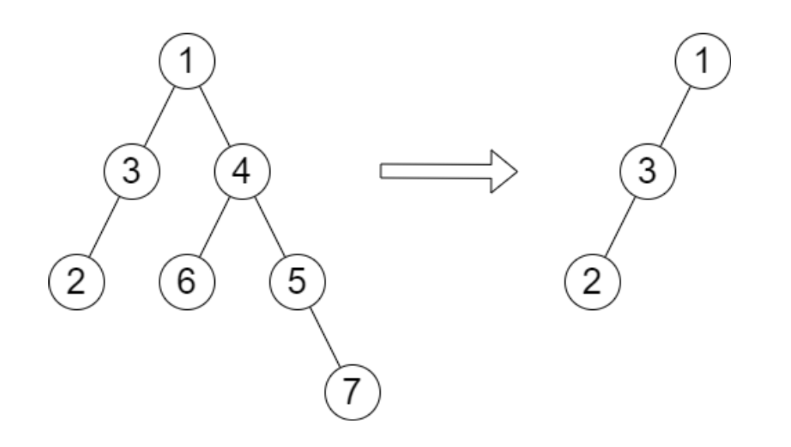
Problem 5: Height of Binary Tree after Removal Queries
Given binary tree T with each node having a unique index
Given m independent queries
For each query, remove the subtree rooted at the given index
Return the height of remaining tree
Given T, query=[4]
Return 2

Slide 161
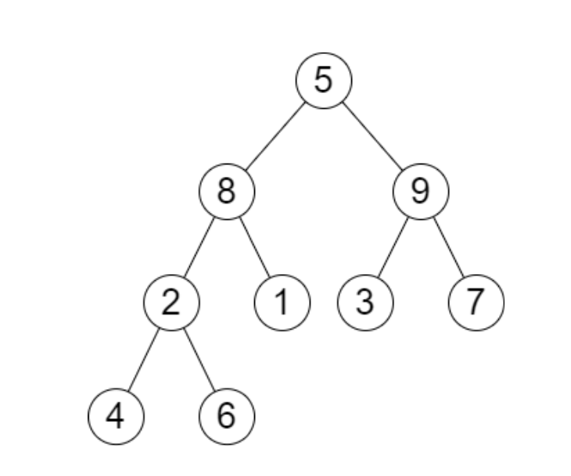
Problem 5: Height of Binary Tree after Removal Queries
Given T, query=[3, 2, 4, 8]
Return [3, 2, 3, 2]

Slide 162
Problem 5 Solution
Naive Solution?
Find height of tree every time we need to
O(n) for finding the height and repeat for m times – O(mn)

Slide 163
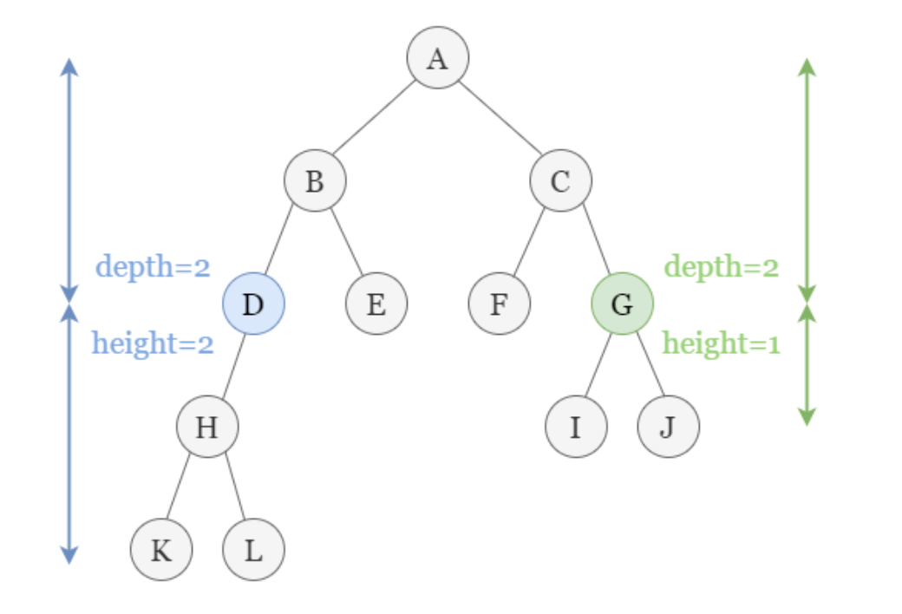
Problem 5 Solution
Better solution?
Recall definition of height and depth of a node (in page 20 and 26)
For each query, find the maximum height h₀ of the remaining node with same depth d₀ as the removed node (h₀=0 if no other nodes with d₀)
Result of query be h₀ + d₀

Slide 164
Problem 5 Solution
Better solution?
Recall definition of height and depth of a node (in page 20 and 26)
For each query, find the maximum height h₀ of the remaining node with same depth d₀ as the removed node (h₀=0 if no other nodes with d₀)
Result of query be h₀ + d₀
What do we need for such a solution?
Find depth and height of each node
a DS to map given index to the depth of the node
a DS to find all the nodes with given depth

Slide 165
Problem 5 Solution
What do we need for such a solution?
Find depth and height of each node
DS1 to map given index to the depth of the node
DS2 to find all the nodes with given depth
How to find depth and height of each node in a tree?
In-order traversal for depth (why?)
DFS for height (why?)

Slide 166
Problem 5 Solution
What do we need for such a solution?
Find depth and height of each node
DS1 to map given index to the depth of the node
DS2 to find all the nodes with given depth
DS1
AVL Tree – storing (index, depth) pair
Array – depth at corresponding index (given unique index 1, 2, …, n)
Similar to idea of hash table, covered in depth soon :)

Slide 167
Problem 5 Solution
What do we need for such a solution?
Find depth and height of each node
DS1 to map given index to the depth of the node
DS2 to find all the nodes with given depth
DS2
AVL Tree – build individual tree for each depth and query accordingly – O(logn) for max n number of nodes in AVL Tree
Is this already the best solution?

Slide 168
Problem 5 Solution
What do we need for such a solution?
Find depth and height of each node
DS1 to map given index to the depth of the node
DS2 to find all the nodes with given depth
DS2
Recall that we only interested in the node with maximum height of given depth
We only store two nodes with maximum height for each depth!
If the queried node is max, return second max
Else return max
If less than two nodes for the level, put 0 as placeholder

Slide 169
Problem 5 Solution
Overall time complexity
Find height and depth – in-order-traversal + DFS – O(n)
Constructing DS1 – tree O(nlogn) / Array O(n)
Constructing DS2 – tree O(nlogn) / Array O(n)
Query cost – tree O(mlogn) / Array O(m)
If AVL Tree used: O(nlogn + mlogn)
If array used: O(n + m) – similar to idea of HashTable, covered in details soon!

Slide 170
Problem 5
Question adapted from https://leetcode.com/problems/height-of-binary-tree-after-subtree-removal-queries/
Try it out if interested!

